Slide 1
SYST36367 Capstone Project Requirements & Design NOTL(Niagara On The Lake) Hydro
Presented by: Team Sprinters

Slide 2
Agenda
Team Introduction
Client & Project Introduction
Project Overview
Quality Assurance Planning
Project Demonstration
Transition Plan

Slide 3




Team Sprinters
Anee Patel
Jashan Goyal
Devansh Patel
Dhruv Rajpara

Slide 4

Client Introduction
Niagara on the Lake Hydro Inc. is the municipality of Niagara-on-the-electric Lake's utility, serving around 10,000 consumers.
Goal : Minimize greenhouse gas emissions and slow the effects of climate change, the corporation aspires to be an industry leader.
Niagara on the Lake Hydro is actively taking steps to minimize its own internal operating emissions, and now wants to help its customers measure, analyze, compare, and ultimately reduce their aggregate carbon footprints.

Slide 5
Project Introduction
Goal
To build an effective web application tool which allow customers to track their carbon emissions over time.
Encourage them to reduce their emissions.
Outcome
Created a user-friendly website as requested by our client.
Enables customers to calculate, compare and reduce their carbon emissions based on utilities like electrical, water, fuel, vehicle, and flights.

Slide 6
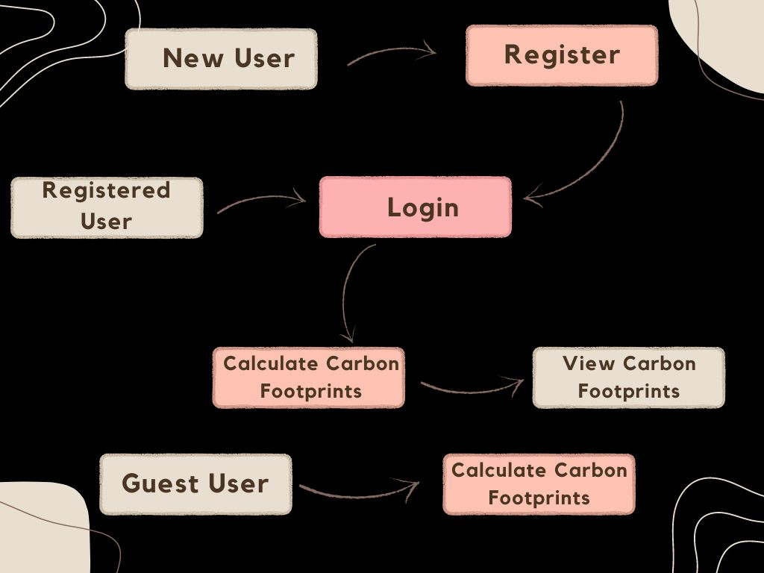
Website Flow

Slide 7








Architecture
Frontend
Backend
Components: Home, Register, Login, Calculators, ViewHistory, etc.
Service: API calls
Controllers – User & CarbonFootprint
Model Classes - User & CarbonFootprint
Tests – API Testing & Unit tests
Database – SQL Server (Microsoft Azure)
Deployment

Slide 8
Quality Assurance Planning
Unit Testing
Created the test cases in .NET for the user inputs to ensure that the valid data is entered in the database.
Compared the user inputs and expected result.
API Testing
Testing the Web APIs for use cases like register, login, add and retrieve footprints using Postman.
Verified that the data is successfully inserted and retrieved from the database with a valid Status Code
Tested and verified the user authorization to retrieve the data from the database
User Acceptance Testing
Performed manual tests to ensure that the main features are working as expected.
Tested main functions like Register, Login, Carbon footprint Calculation, and Footprint history.

Slide 9
Web Application Demo

Slide 10
Transition Plan
Project
Provide GitHub access to allow the client to download and edit the project source files.
Deployment
Create Microsoft Azure Account
Purchase the Microsoft Azure subscription.
Provide zipped project build files for quick deployment.
Provide proper documentation on
Azure database creation
App Services (Frontend + Backend)
Setting Security Firewalls

Slide 11
Thank You!

